Slide 1
Team Foint Glizzy
Team Foint Glizzy will be creating
a game for our Senior Design Project.

Slide 2
Team
Bailin Zhen Email: zhenbn@mail.uc.edu
Matthew Estes Email: estesmw@mail.uc.edu
Vitta Silberberg Email: silberjm@mail.uc.edu
Hari Koirala Email: koiralhi@mail.uc.edu
Advisor : Evan Torner Email : torneren@ucmail.uc.edu

Slide 3
Abstract
We plan on creating a fantasy 2D action roguelike cave-diving game with a character-based ability system. Randomized item drops and semi-randomized maps and enemies will create varying playthroughs so each run is a new experience.

Slide 4
User Stories
As a Player, I want to be able to find useful loot as I progress through the levels. This enables me to have fun and challenge myself to a higher level. As a Player, I want to fight a variety of enemies that are unique and fight bosses that have interesting mechanics. As a Developer, I want to create a scalable loot system so when I need to add something new, it's easy to do and something I could balance easily. - Hari Koirala
As a player, I want to feel each run is unique and different, while still feeling that I could always succeed with enough skill. The randomness should force me to use different tactics and play styles each run while still being balanced so that even extremely bad luck can be overcome with skill. - Bailin Zhen
As a player, I want a game with familiar, learnable mechanics which reward practice and skilled gameplay. Elements of randomness should affect the decisions I make, rather than the likelihood that I succeed. As a developer, I want to create game mechanics which feel rewarding and intuitive. Game design decisions are paramount to me, and I want them to be visibly strong to any outside perspective.
- Vitta Silberberg
As a player, I want the code to run efficiently on my machine so that it doesn’t overuse processing power. This will allow my system to handle the game smoothly, without lag or slowdowns. Ultimately, I want to enjoy a seamless and engaging experience without technical interruptions. - Matthew Estes

Slide 5
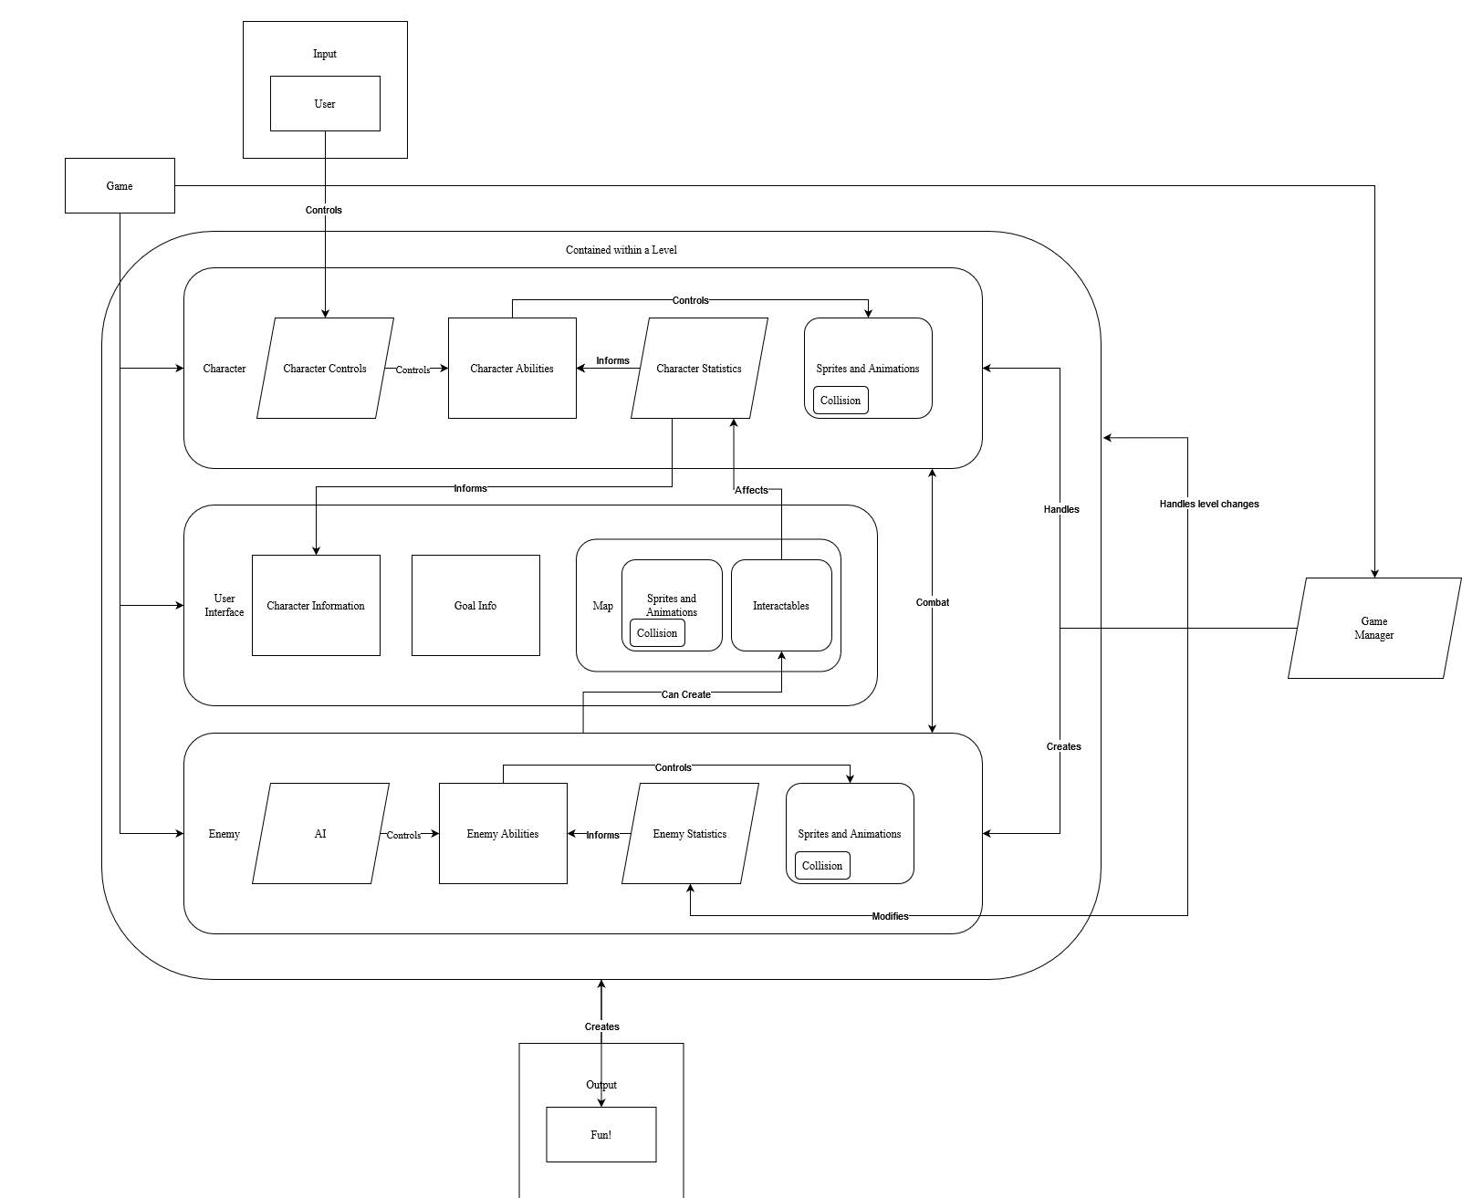
Design Diagram

Slide 6
Project Constraints
Economic Constraints
We are lacking in our budget to hire professional artists for music/sound/art design, and none of us are art students. We need to either make our own ameteur assets or use free/cheap assets
Security Constraints
If we reach our stretch goal of multiplayer, we must ensure player security.
Legal Constraints
We must make sure we make our IP and mechanics distinct enough so that we do not infringe on any copyrights

Slide 7
Review of Progress
Research
Reviewed various game engines and their traits, selected Godot
Preparation
Initial testing and learning of Godot Engine for all team members
Planning
Roughly mapped out a software design diagram for major scenes required for game

Slide 8
Expected Accomplishments
By the end of the year, we want to have a proof of concept for our game. This would involve
One character with very simple abilities
A very small test stage with collision
A dummy enemy which the player can interact with. No AI implemented yet
3 basic items which can be collected and impact player statistics

Slide 9
Division of Work
General Programming
All
VFX (Particle systems, projectiles)
Hari Koirala
Art & Sound Design
Vitta Silberberg
Optimization / Document Project Progression
Matthew Estes
UI / Menuing Design
Bailin Zhen

Slide 10
Expected Demo
Minimum presentable product would be a playable game with
1 Full Character, with 4 abilities
1 Large Map
1 Boss
~5 Normal enemies
~15 Items
Expected product
4 Full Characters
3 Maps
3 Bosses
~15 Normal enemies
~45 Items
Stretch Goals
Additional Content
Modular Ability Sets for Characters
Multiplayer

